Slide 2
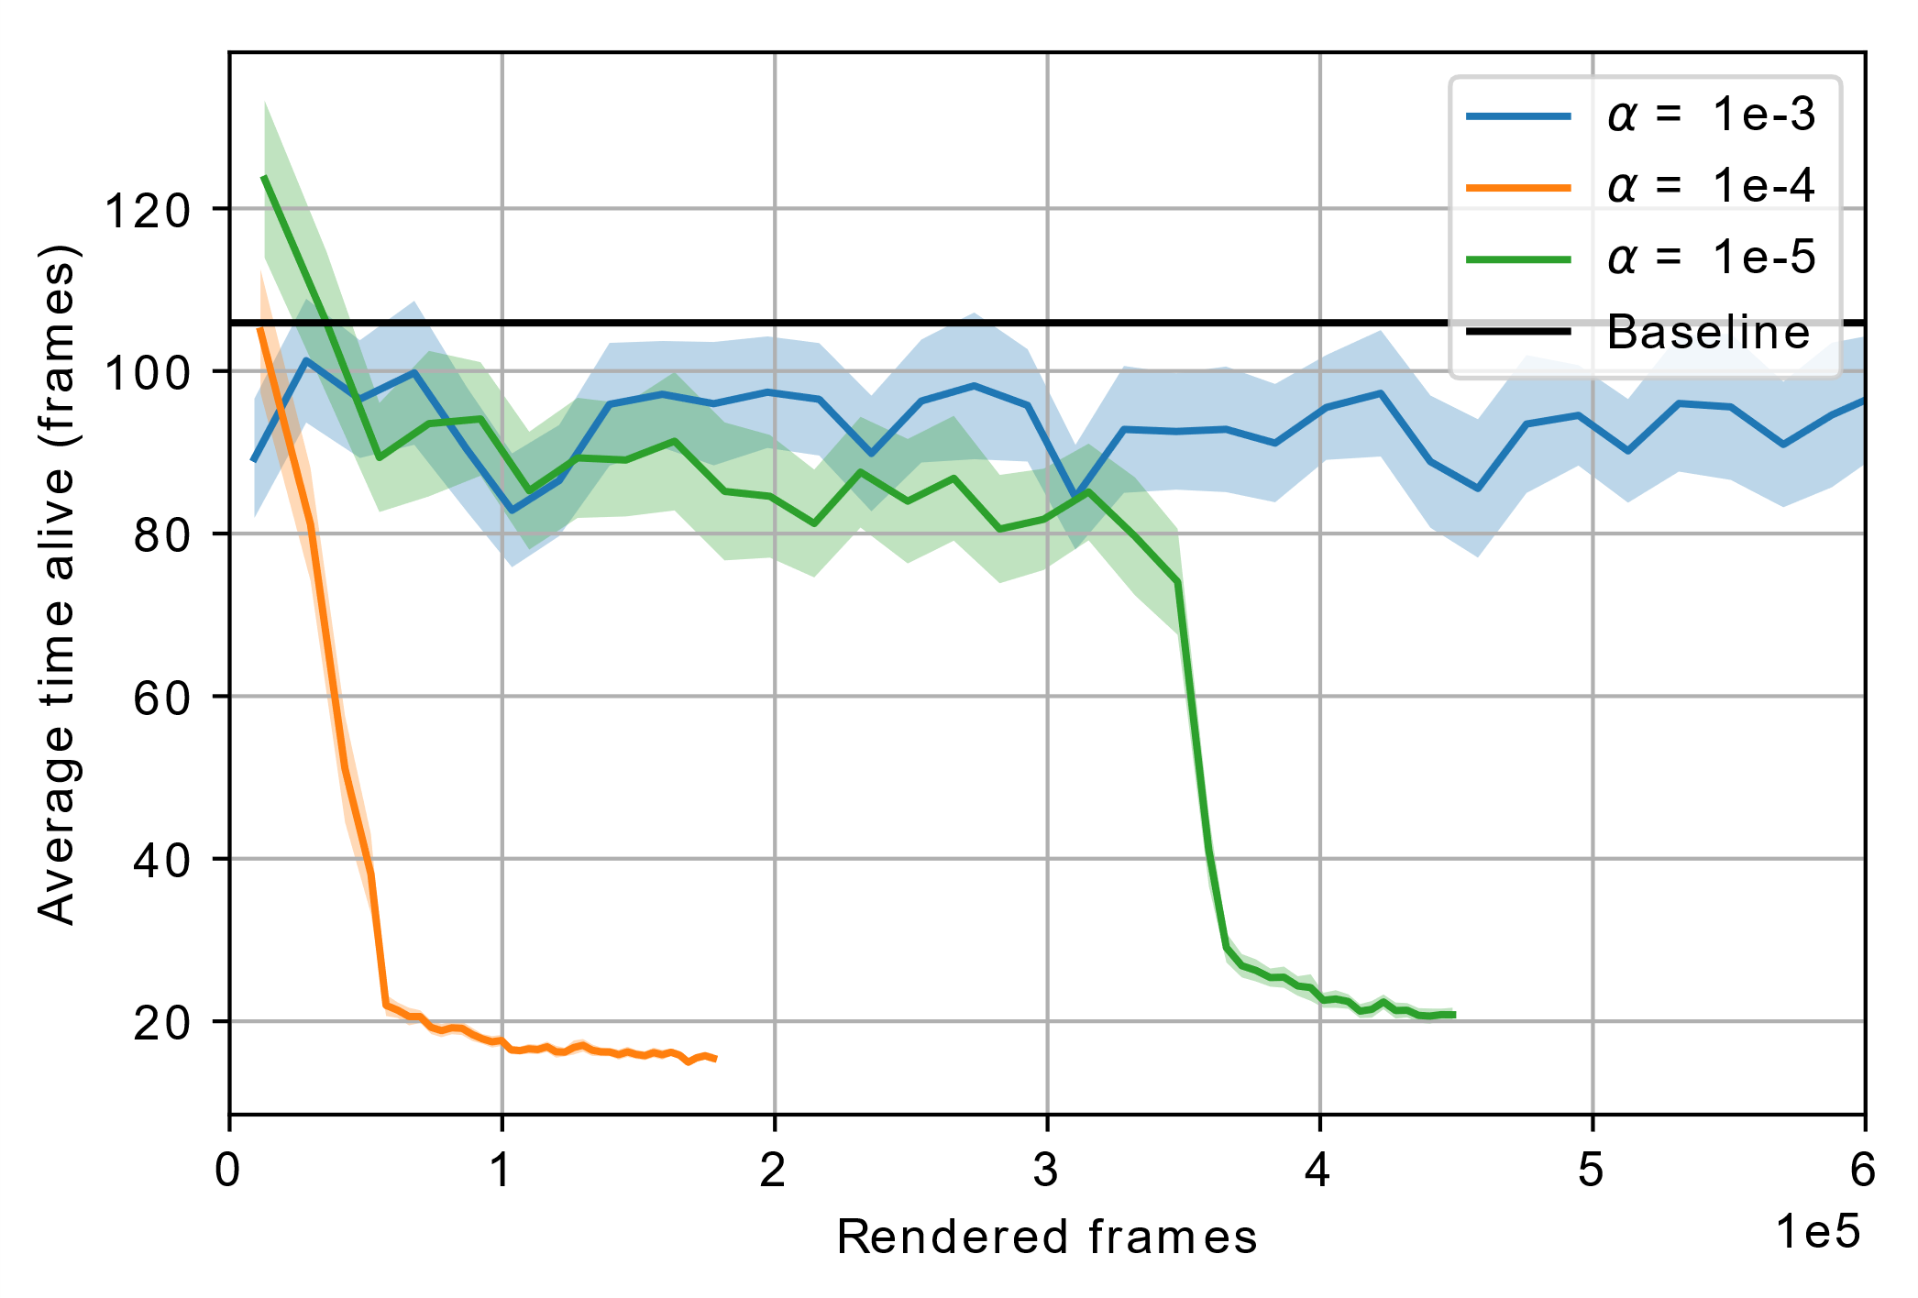
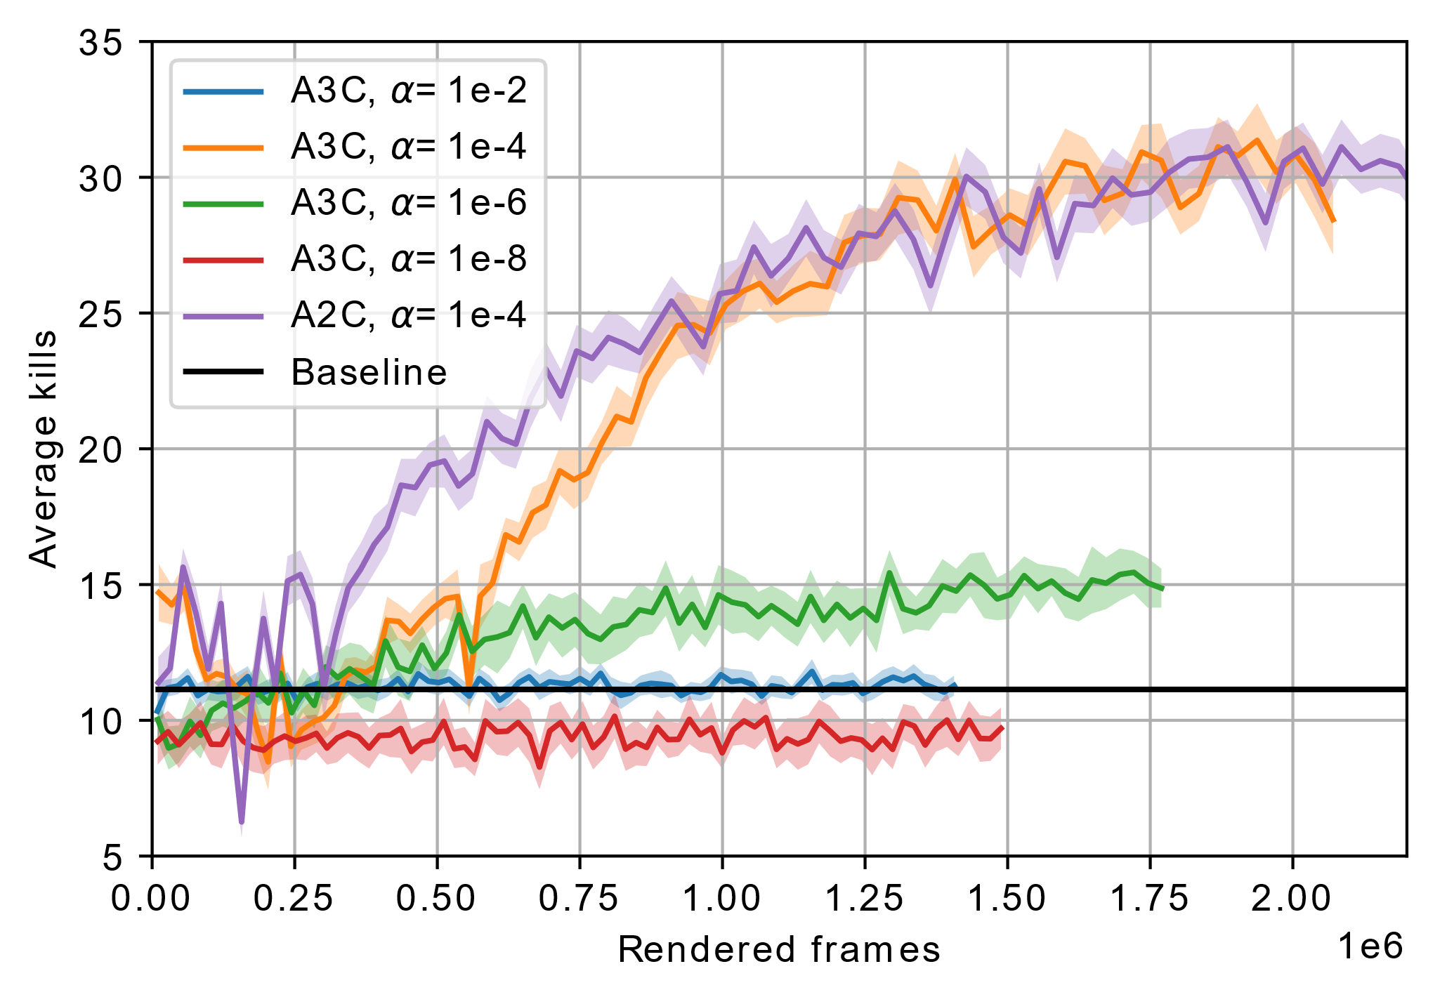
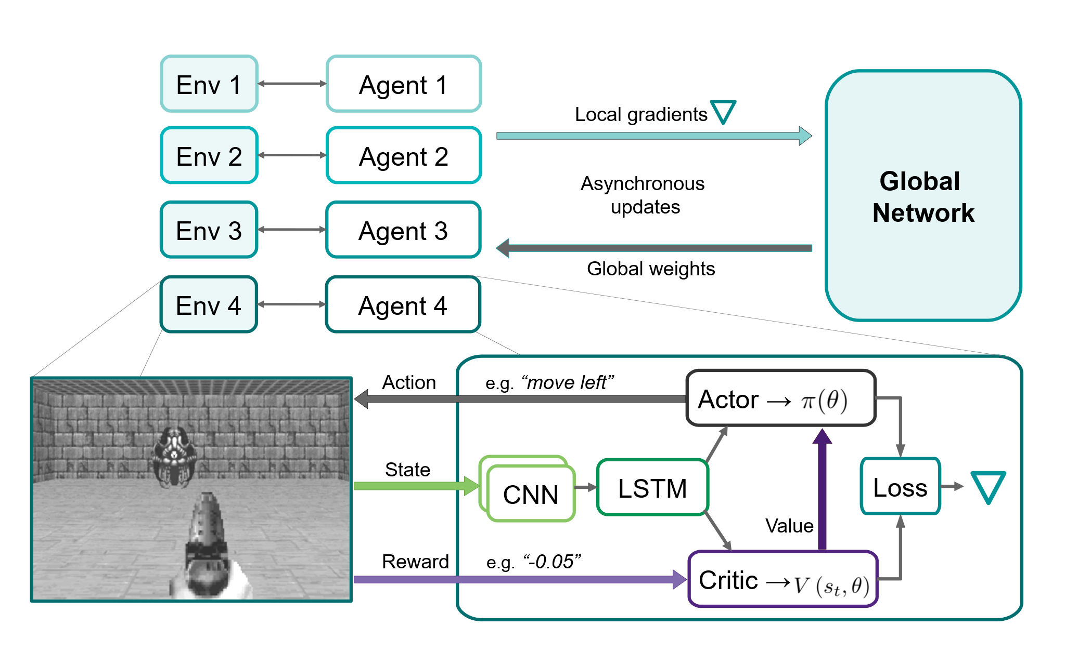
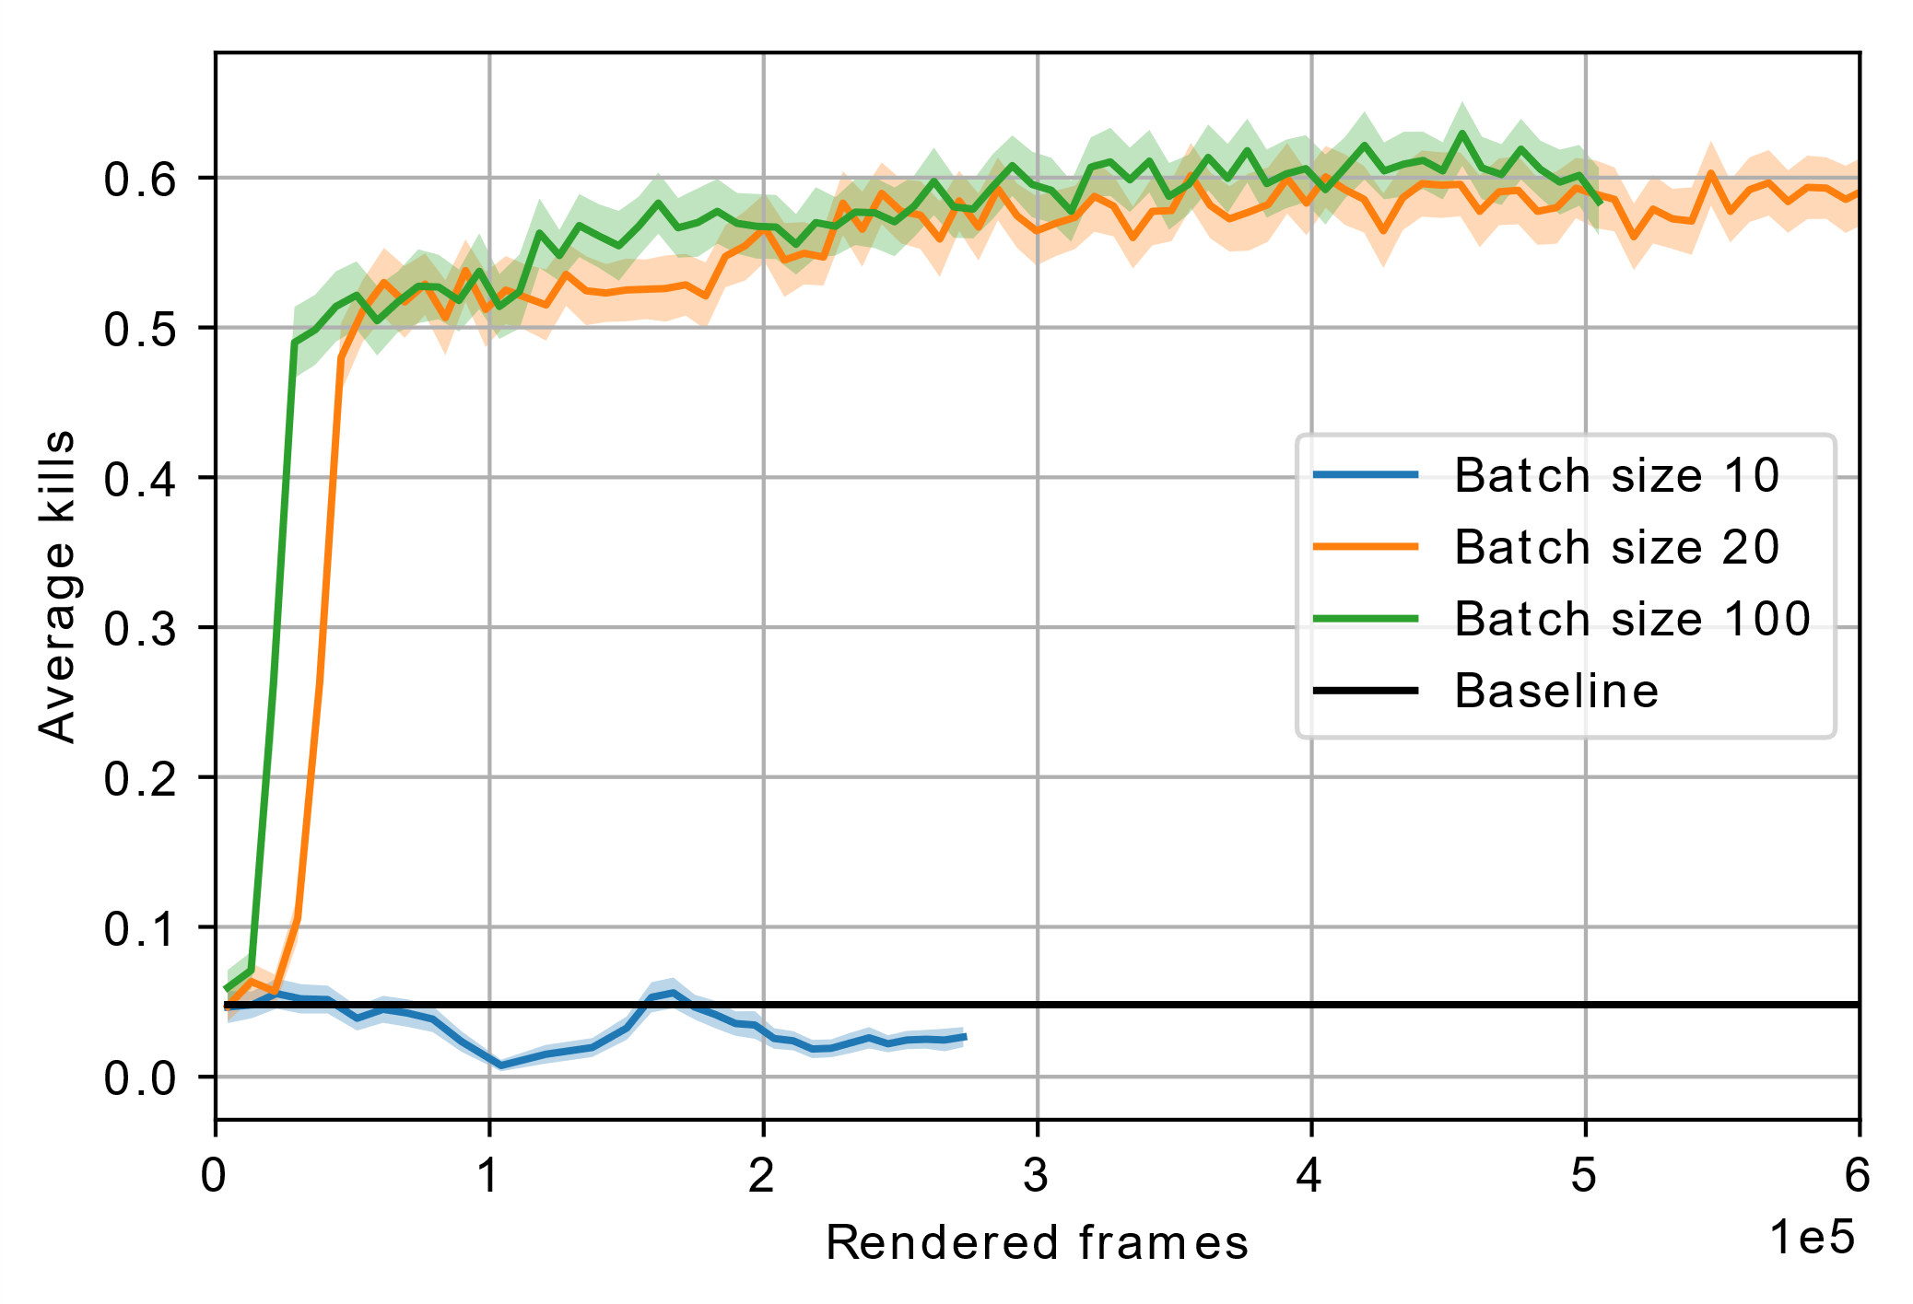
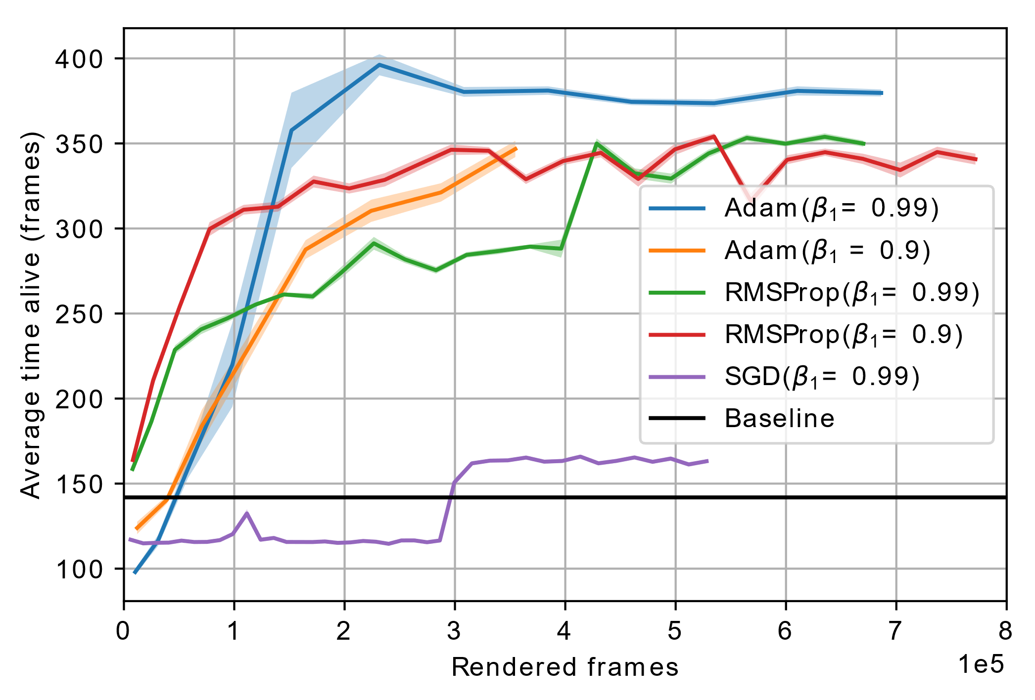
Asynchronous advantage actor-critic methods on ViZDoom
Basic
Defend the line
Task:
Learn behavior to maximize a given reward in various enviroments
Challenges: Partially observable enviro/ment
Only pixels and reward signal as input
Sparse or delayed rewards
Best learning rate 1e-4
Learning rate 1e-4
Predict Position
Defend the center

